Slide 1
Dynamic Hand Gesture Recognition using Neural Network
Team :
Thevaprakash P – 19MIM10003
Krishna Basak – 19MIM10050
Shinjan Verma – 19MIM10061
Kesavan R – 19MIM10086
Team Guide :
Dr.v Pandimurugan
Program chair, integrated m.tech (ai & ml)
Vit Bhopal university

Slide 2
Agenda :
Introduction
Existing work with limitations
Proposed work and methodology
Novelty of the project
Real time usage
Hardware & software requirements
Overall system architecture diagram
Literature review
Module description
Module workflow explanation
Implementation
Coding
Demo video
Snapshot of project

Slide 3
INtroduction
Gesture Recognition in an important and active field of Computer Vision. Gestures can be Static or Dynamic ( Motion ), But direct use of Hand can be more attractive and natural way of conveying the meaning to the
Humans and Computer. But it also depends on the speed of motion and latency.
Gesture recognition has wide-ranging applications in human-computer
interaction, sign-language communication, video surveillance, dance/video
annotations and forensic identification

Slide 4
Need of this project :
Now its Corona Pandemic , suppose we need use the public pc its more risky for getting infecting, so interact with computer with distance we can be more safe
And also it will bring a huge evolution to touchless hand gesture recognition systems in future
And also its evolving

Slide 5
Existing methods with limitations
Existing methods for only numbers and some basic gestures so we can’t do it for all, Meaning tend to be change always
We have use this gestrues to interact with the computer
For example,
swiping your hand sideways can change the tabs open in the PC.
Existing methods for only numbers and some basic gestures so we can’t do it for all - meaning tend to be change always. We have use this gestures to interact with the computer.

Slide 6
Mostly People uses some of the Sensors for identifying the motion
The most widely used sensors for identifying motions is
Kinect
Leap Motion
But We have used here only the camera, So the price of the projects will be reduces upto 7000 Indian Rupees

Slide 7
Proposed work and methodology
We can segment our proposed work in three units/modules –
CNN Model Generation: Here, we will use a database of images and make a CNN model, train it to classify the images and any other same kind of image.
User Feed Taking: Now, as we have made the CNN model, we will use this model to predict the gesture from real time live video feed.
Doing the Task: As the prediction goes on, the system will do the task assigned to each gesture when they are predicted.

Slide 8
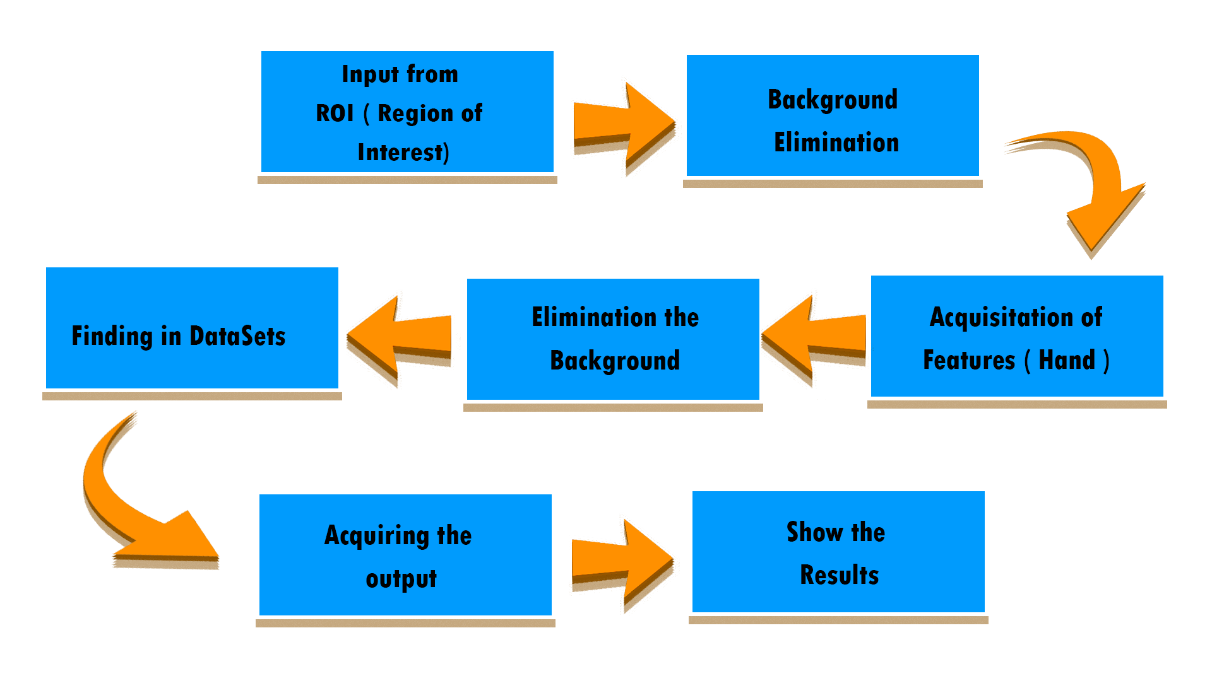

Slide 9
Novelty of the project
Most of the gesture recognition projects consist of some kind of sensors. Those sensors are used for the prediction of Motion.
But this project does not use any of those sensors for prediction. Rather it just takes input from camera and Do the Respective Jobs.

Slide 10
Real time usage
Touch screen generation
This can be used to generate touch screen kind of facility to those devices that don’t have it.
Controlling devices
With computers learning and knowing the various human hand gestures, many devices can be controlled without physical interaction.
Sign language detection
The hand gesture recognition will help to determine sign languages by movement of understanding hand and analyzing them.

Slide 11
Hardware and software requirements
Hardware :-
Web Camera
Software :-
Python3
Sublime Text
Tensorflow for Neural Network
OpenCV – for detecting Hand
Numpy

Slide 12
Literature Review
From the Existing Research Papers we found that Human Computer Interaction has a more More important active field, One of the Major Field of computer vision in the interpretation of human gestures. Hand gestures would be a way of exchanging information with other people in a virtual space, guiding some bots to perform certain tasks in an environment, or interaction with the computers.In that we have two different mode of recognitions like One is the Vision Based model but this depends on the Enviroinment and another is sensor based with needed background things like lights and isolated Enviroinment
But we have taken a vision Based Model for gesture Recognition, Gesture recognition is an mathematical interpretation of a human motion to a Computer,The vision-based approach deals with the Video Capturing, image processing and pattern recognition.For this we have to use the CNN classifier to determine the shape of the hand. In the vision-based approach they have avoided the skin color segmentation. The aim is to recognize dynamic hand gestures with maintaining the high accuracy and the time taken to recognized gestures Fom the Beginning they were used the sensor based devices like Use of electronic hardware, but it was Complex to use because the Physical attachment with the model is required and also more noise were produced while movement and they come up with the gloves but it also have a simultaneous Problems and Kinect find a solution but it was more costly so implementing for all it was more difficult so we have proposed to work the same functionality in our computer systems with the use of laptop or computer's webcam

Slide 13
Literature Review
so we have proposed to work the same functionality in our computer systems with the use of laptop or computer's webcam
References :-
Professor Akshatha G1, Bhavani Patil2, Harshitha P3, Sindhushree M41Project Guide, Computer Science and Engineering, DSCE, Bangalore-560078
Shengchang Lan, Zonglong He, Haoyu Tang, Kai YaoWenshuang Yuan Department of Microwave Engineering, Harbin Institute of Technology Harbin, China
Xu Pan, Ting Jiang, Xudong Li, Xue Ding, Yangyang Wang, Yanan Li Key Laboratory of Universal Wireless Communication, Beijing University of Posts and Telecommunications Beijing, China
Real Time Gesture Recognition System for Interaction in Dynamic Environment Siddharth S. Rautaraya, Anupam Agrawalaa , Indian Institute of Information Technology, Allahabad, 211012, India
Dynamic Hand Gesture Recognition Using the Skeleton of the Hand Bogdan Ionescu, Didier Coquin, Patrick Lambert & Vasile Buzuloiu EURASIP Journal on Advances in Signal Processing volume 2005, Article member: 236190 (2005)

Slide 14
Module Description
As mentioned earlier, our first module is about making the CNN model.
For that, we will be using keras (interface for tensorflow) to make a CNN model and train – test model using local database of images.
Steps:
Loading the train data (images) and test data (images).
Resizing or reshaping them. Then segment hand region.
Declare the list of gestures.
Define the keras layers.
Compile the model.
Training the model using the train data.
Testing the model using the test data.
Saving the model data as a H5 file.
Reference:
https://blog.keras.io/building-powerful-image-classification-models-using-very-little-data.html
https://medium.com/intuitive-deep-learning/build-your-first-convolutional-neural-network-to-recognize-images-84b9c78fe0ce
https://youtu.be/AACPaoDsd50
And others.

Slide 15
Module Description
Our second module is about predicting the gesture through live video feed.
For that, we will be using OpenCV for all the video and image processing, numpy to make images as array and lastly tensorflow keras to predict the gesture.
Steps:
Loading model data (H5) file.
Getting live video input via OpenCV.
Cut the video into single frames.
Process the frames using OpenCV.
Convert the frames into a numpy array.
Predict the gesture using the H5 file.
Reference:
https://www.kaggle.com/
https://stackoverflow.com/
https://opencv-python-tutroals.readthedocs.io/en/latest/py_tutorials/py_imgproc/py_thresholding/py_thresholding.html#thresholding
https://docs.opencv.org/master/index.html

Slide 16
Module Description
Third module is about doing the task accordingly as the predicted gesture.
For that, we will be using PyAutoGUI for controlling the mouse and keyboard in PC. Though the system can be modified to do other tasks.
Steps:
Installing PyAutoGUI.
Assign a task to each gesture.
Get the predicted gesture (previous module).
Do the task as assigned.
Reference:
https://pyautogui.readthedocs.io/en/latest/

Slide 17
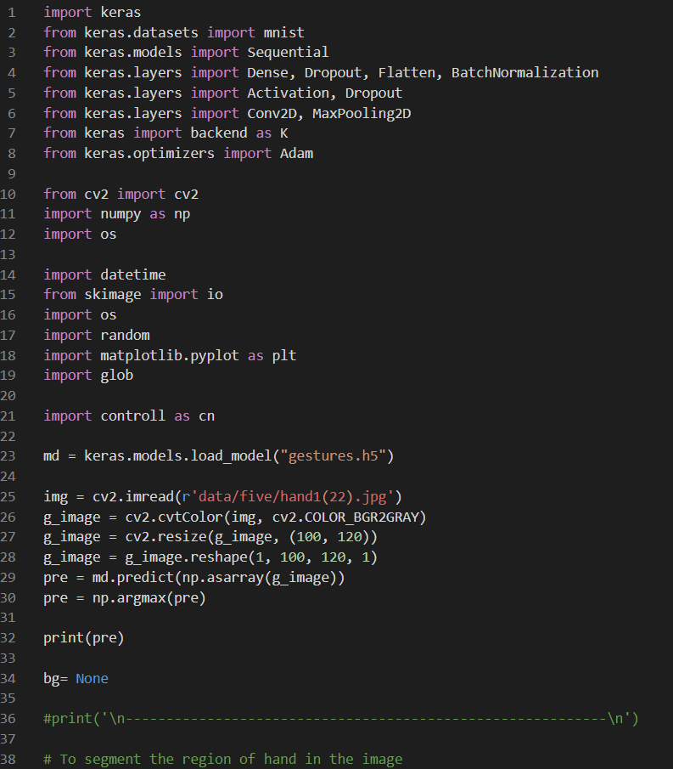
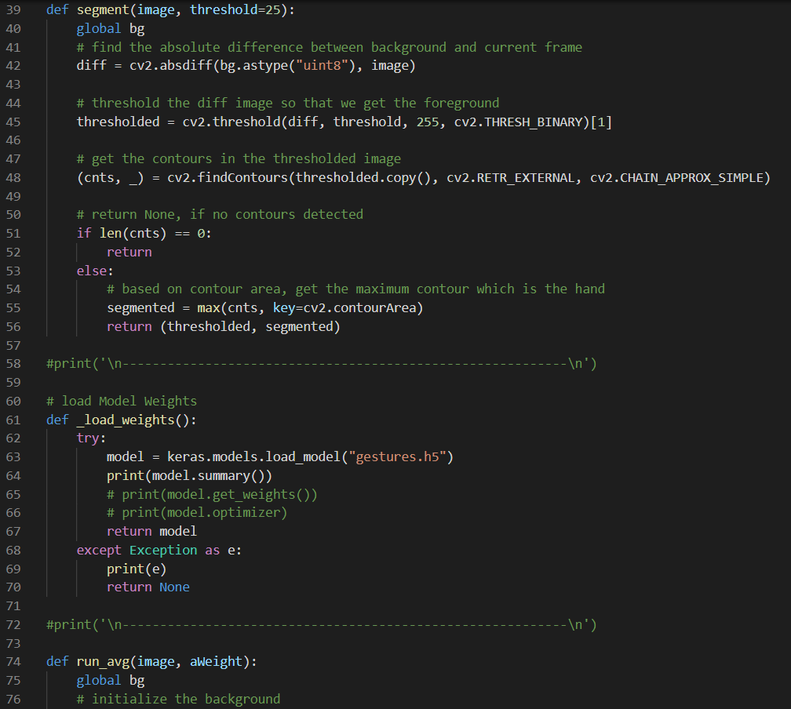
Implementation and coding

Slide 18
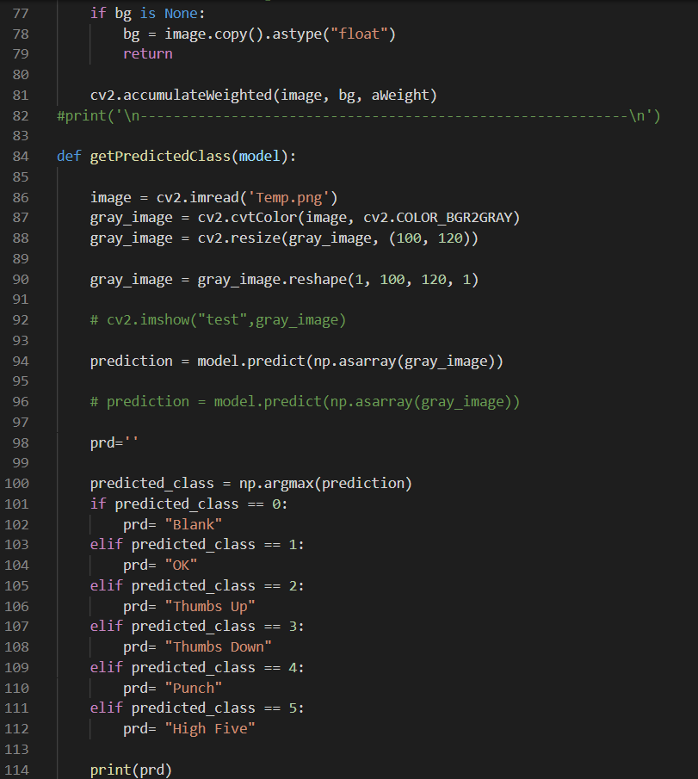
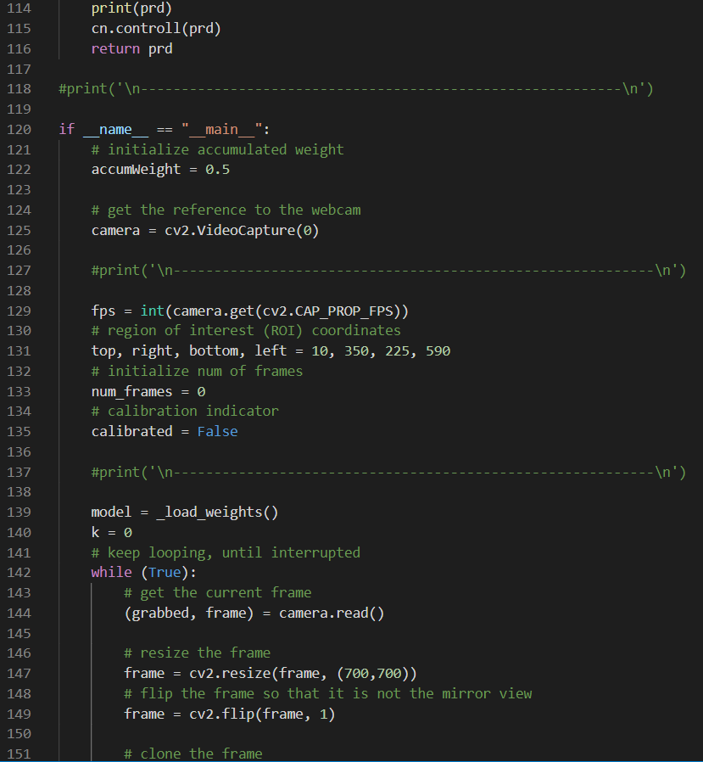
Contd..

Slide 19
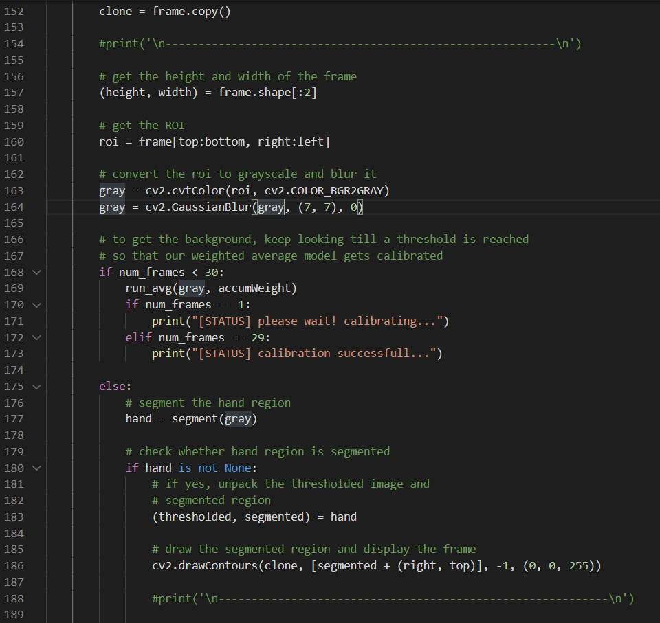
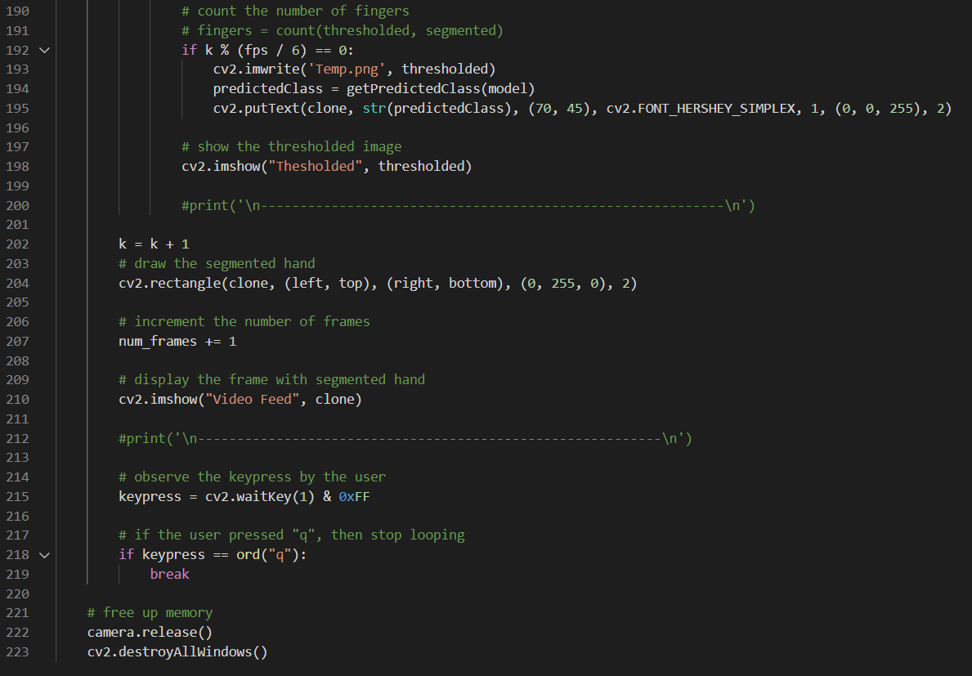
Contd..

Slide 20
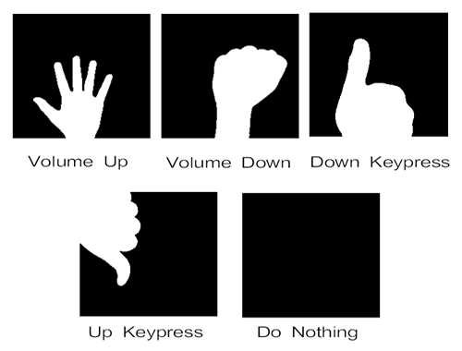
Implemented features

Slide 21
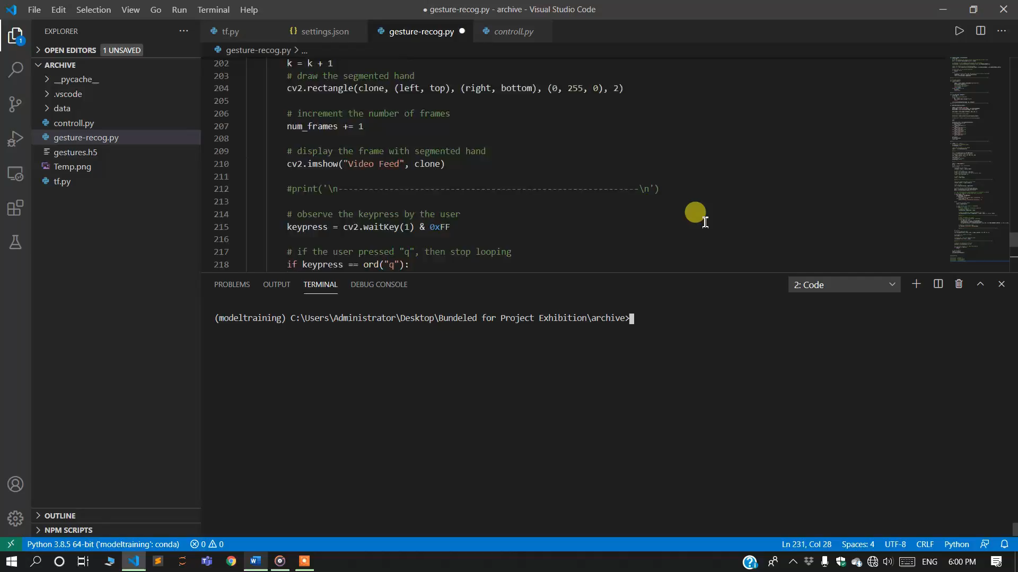
Demo Video

Slide 22
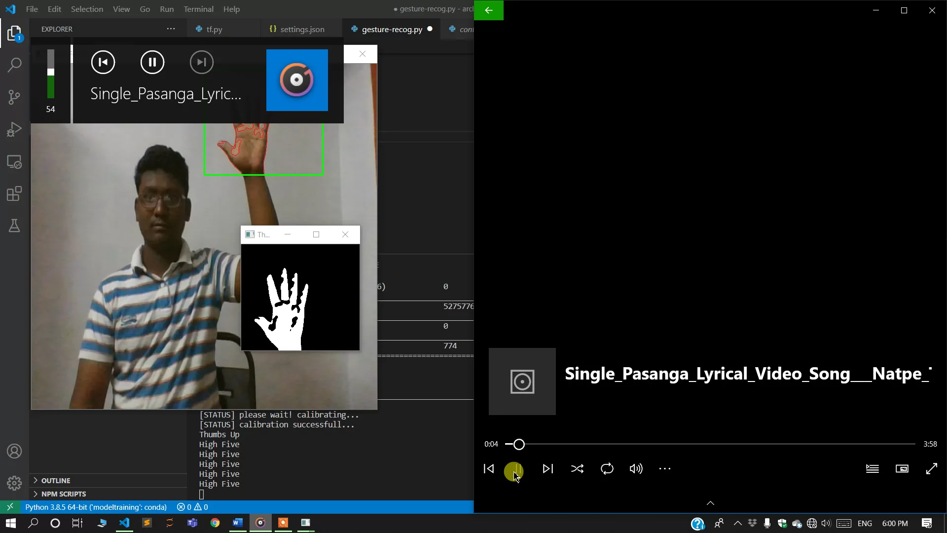
Snapshot

Slide 23
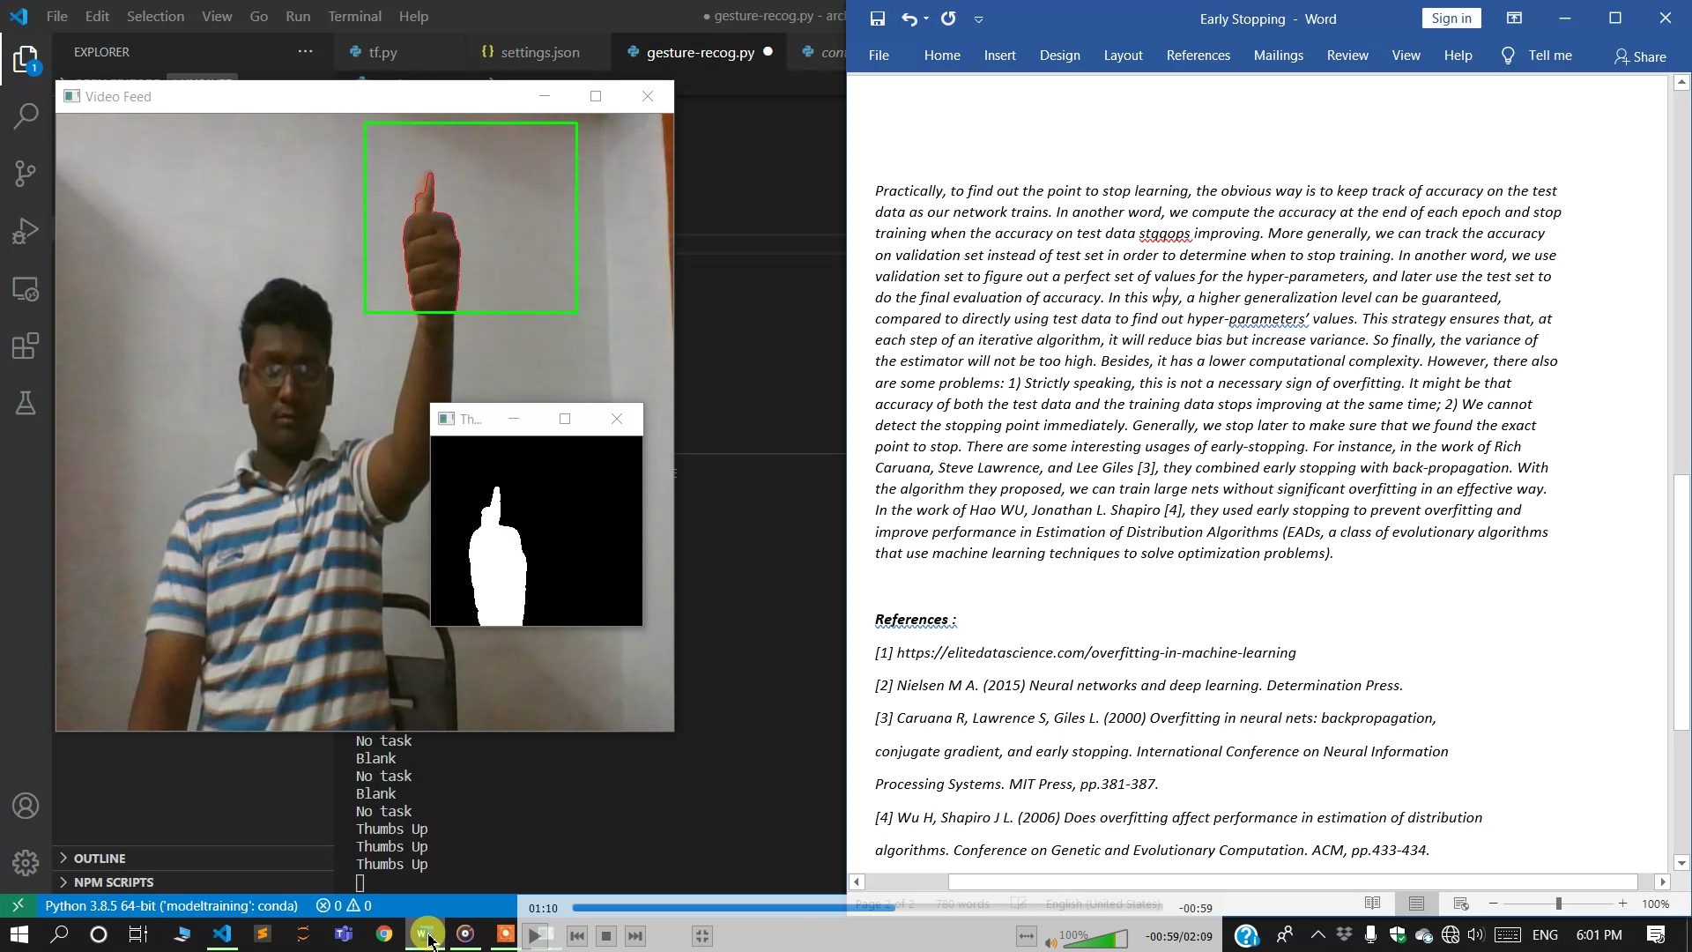
Snapshot

Slide 24
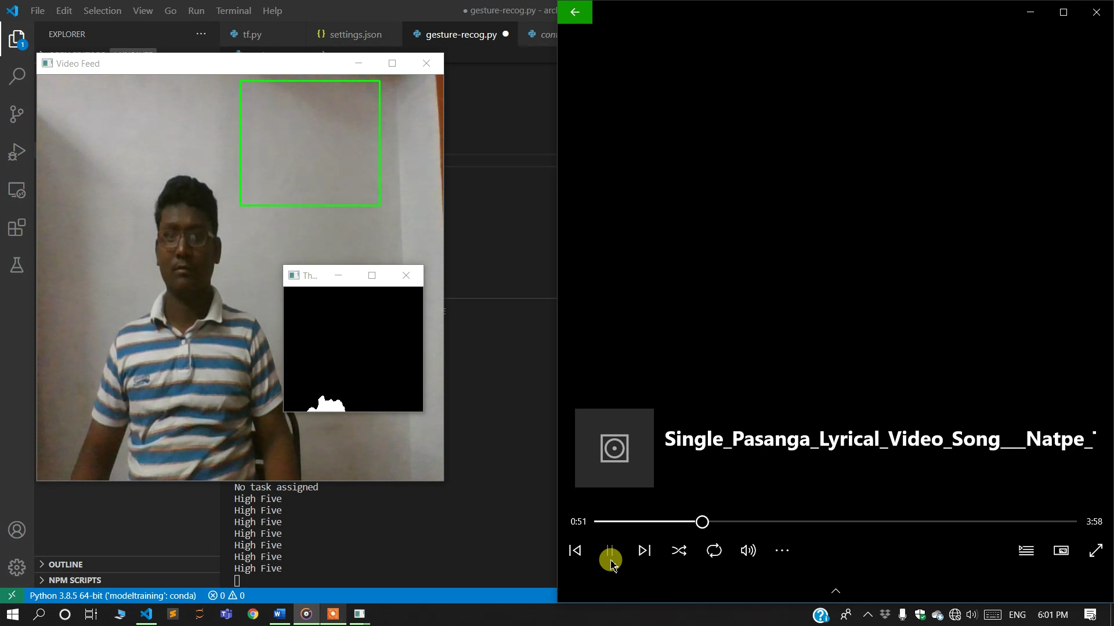
Snapshot

Slide 25
Thank You
Submission for –
Project Exhibition – I
Fall Semester 2020-21
VIT Bhopal

